Slide 1

POWER of EMOTIONS

Slide 2
Contents
Introduction
Machine Learning Models
Deep Learning Models
Pre-trained Models and Transfer Learning

Slide 3

Introduction
A collection of English Twitter messages meticulously annotated with six fundamental emotions: anger, fear, joy, love, sadness, and surprise.
Reference: Kaggle.com

Slide 4
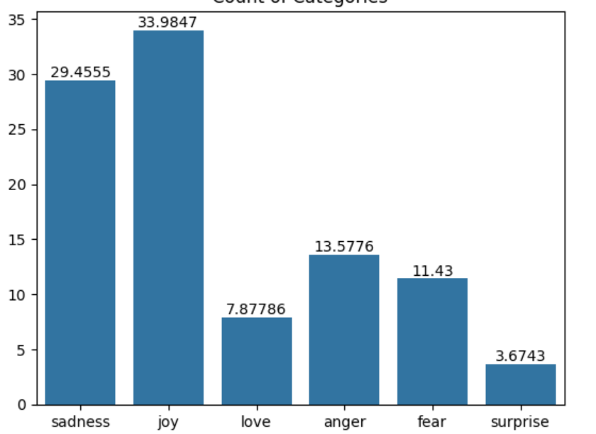
List of Emotions

Slide 5
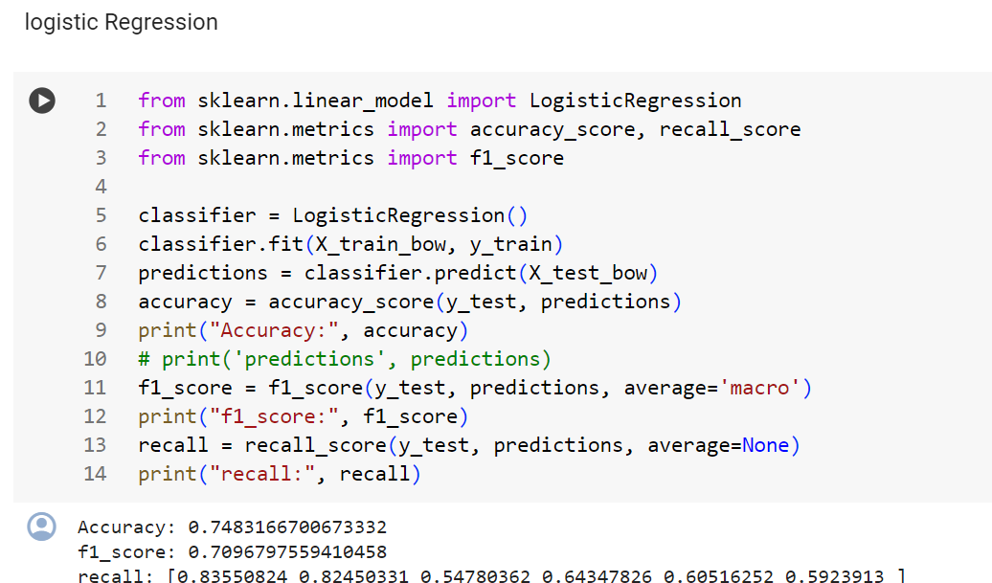
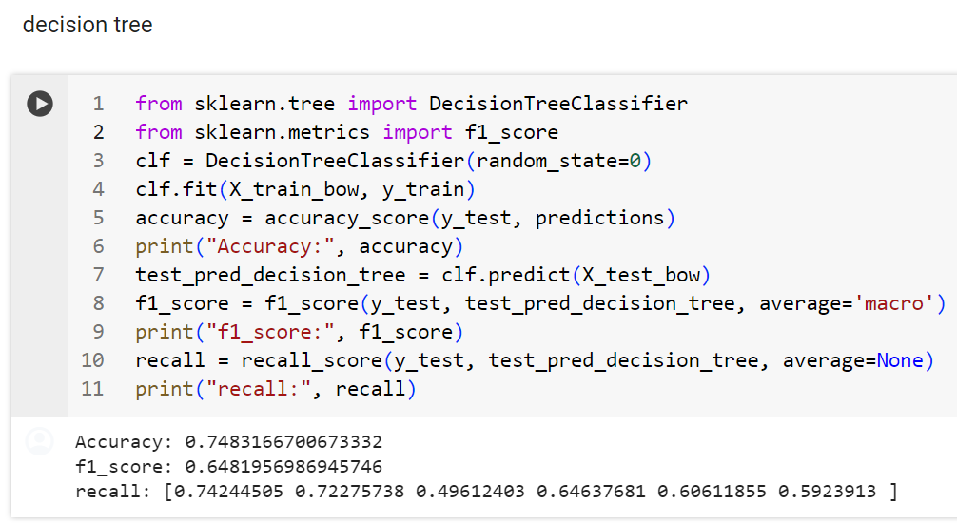
Machine Learning Models

Slide 6

Bidirectional GRU
Using Bidirectional GRU on Emotion Analysis:
Load Textual data and preprocess and clean the texts.
Tokenization and inter encoding using Tokeinzer Class.
Padding .
Train a Bidirectional GRU. to Get good Accuracy.
Visualize Results.
Do Evaluations on Test Data.

Slide 7
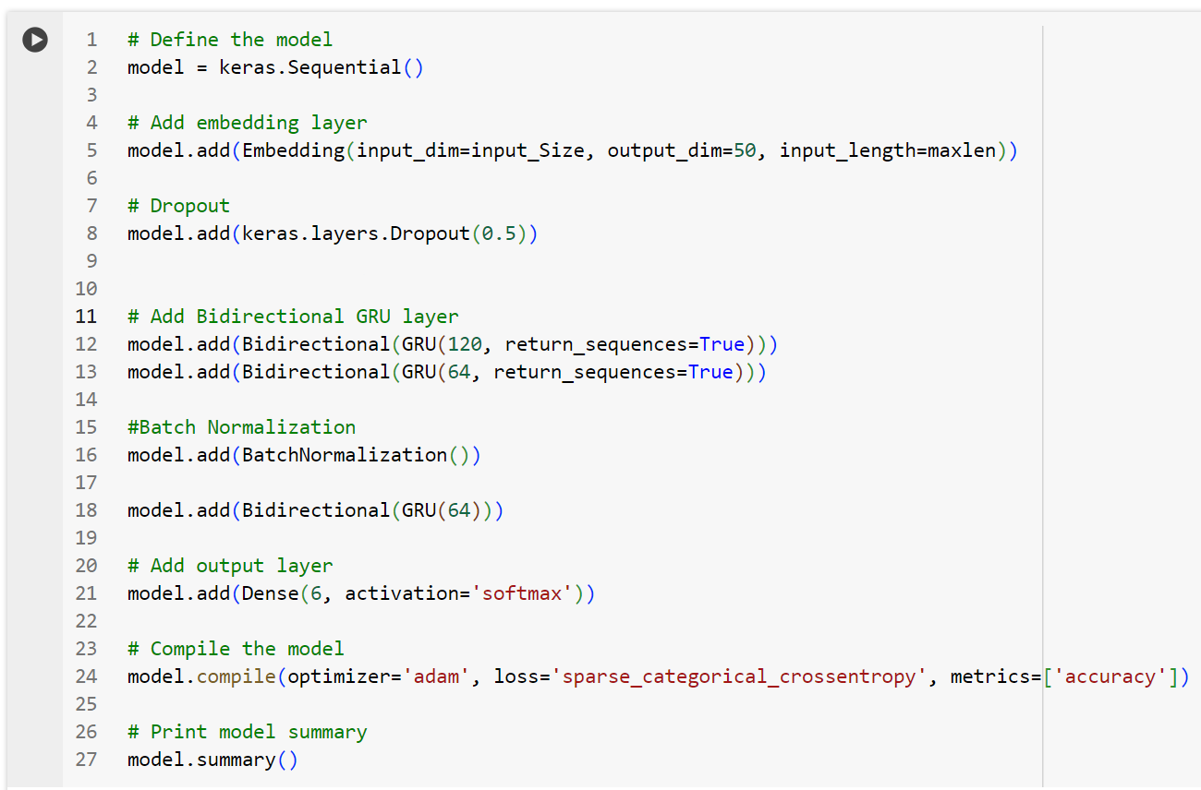
Deep Learning Model

Slide 8
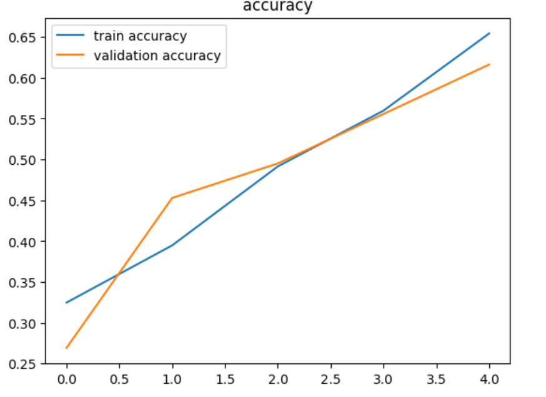
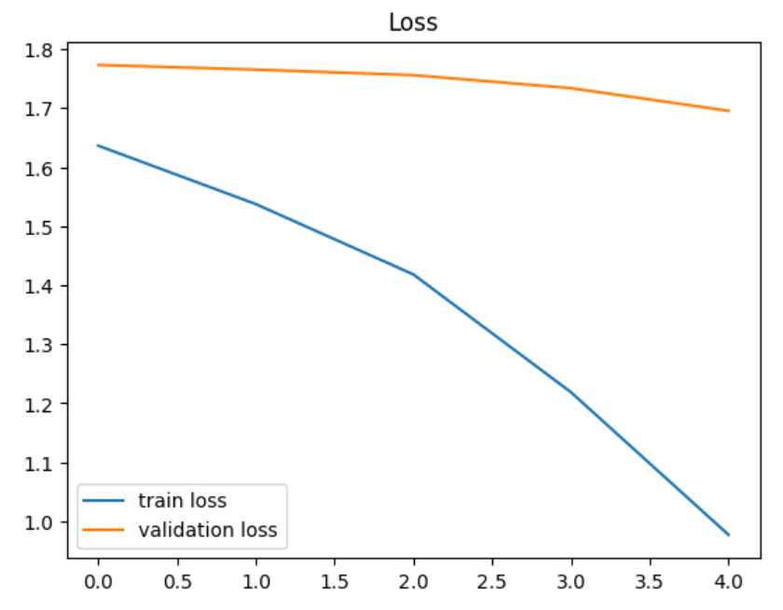
Result of Deep Learning Model

Slide 9
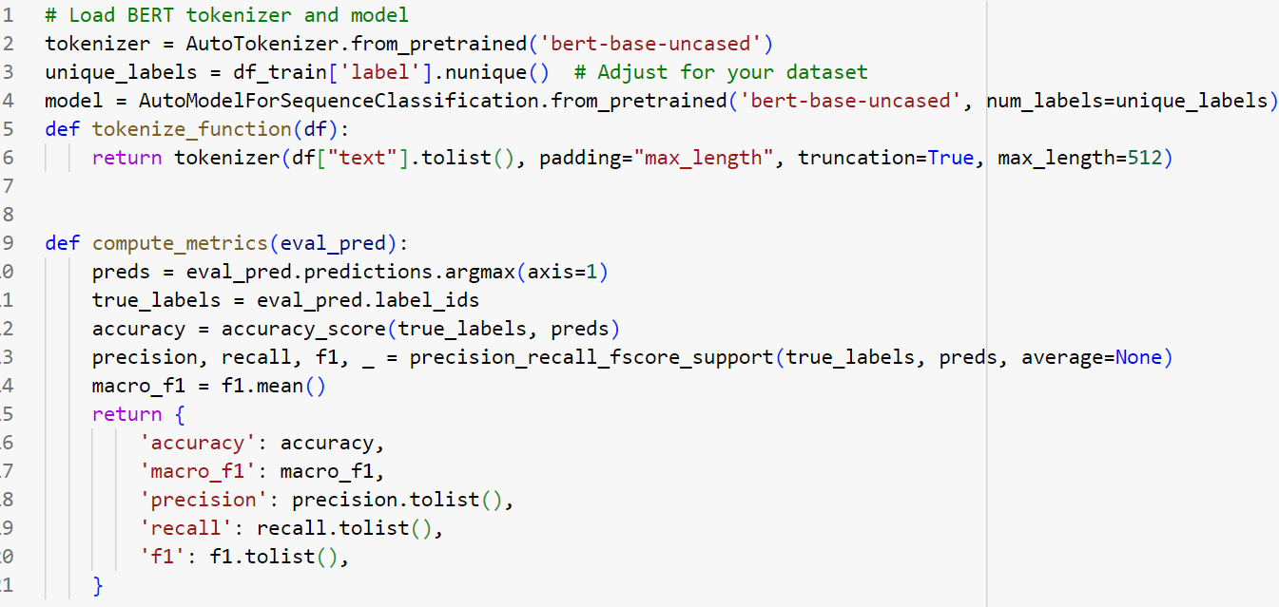
BERT MODEL

Slide 10
Result of the BERT Model

Slide 11
Thank you
Fatima Vahidnezhad

